Slide 1

OSINT
Certification follow-up

Slide 2
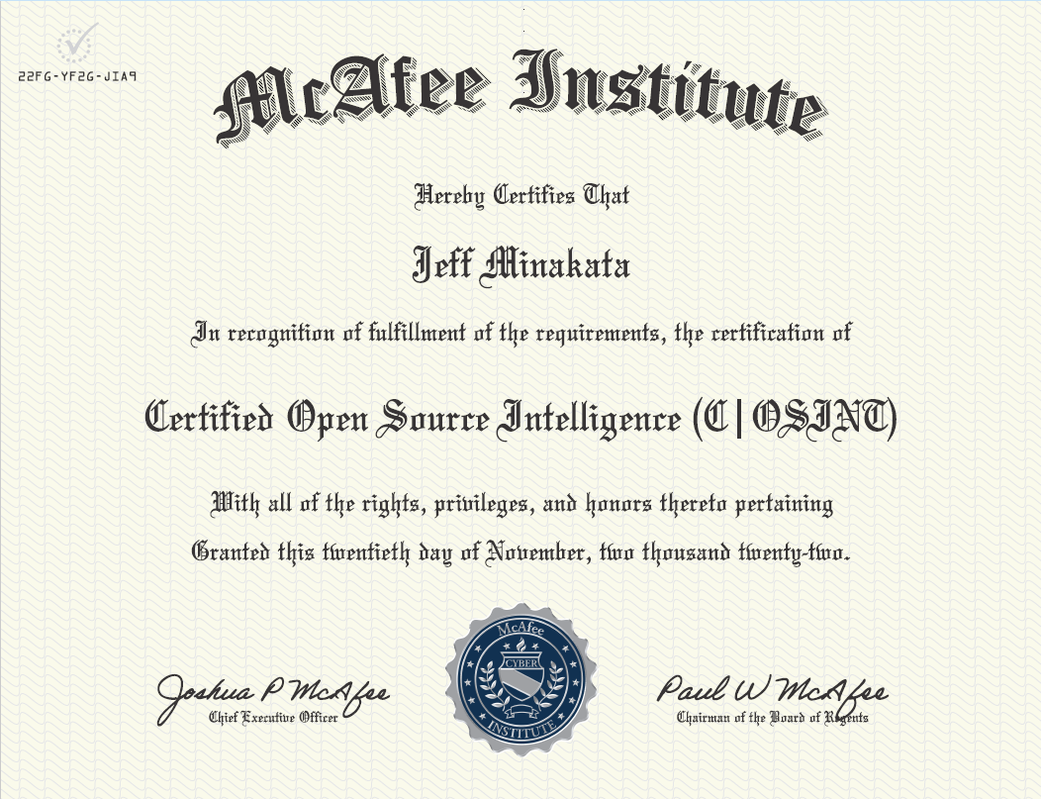

Slide 3



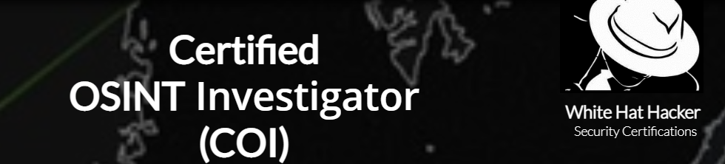

Slide 4
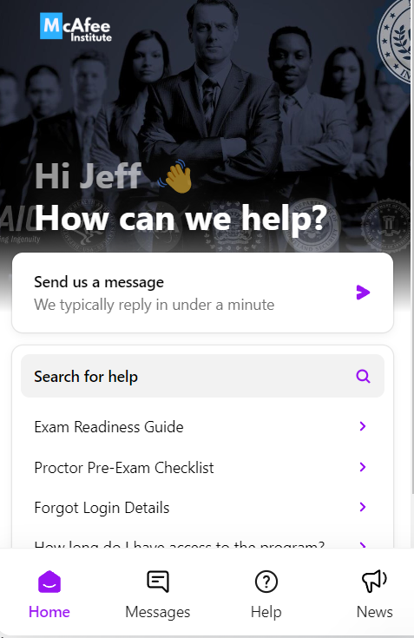




Impressions
Communication Critical! The site should be easy to get a hold of, freely answer questions before you buy, during, after. Excellent customer service, fast response.
Up to date The information was up to date and relevant.
Accredited|Certified|Endorsed It’s important to see who endorses/recognizes the certification. It’s your time and money that you are spending on this.

Slide 5
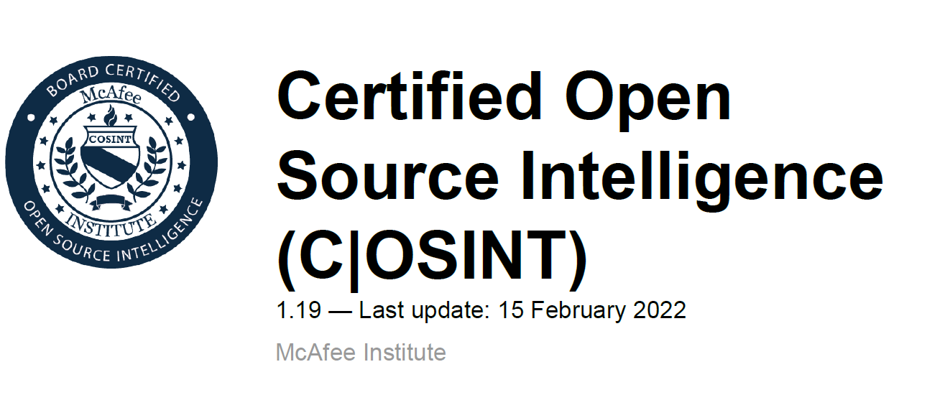
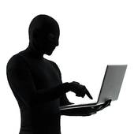
PDF
Online

Slide 6

Online quizzes

Slide 7

Test requirements
Clear off your desk
No photos, notes, pens, other electronics
1 monitor only
Scan your room
Close all apps
No food or drink
Must have a web camera
Scan your room, top of the desk and under
This is a live proctored test

Slide 8

Final considerations
Getting your certification can be incredibly rewarding
Great way to show people and employers your ability and credibility
Evaluate why you want a certification
Determine which certification suits your needs
Consider which certification will be recognized by current or potential jobs and/or clients

